Slide 1

RUNGTA COLLEGE OF DENTAL SCIENCES & RESEARCH
TITLE OF THE TOPIC-
PRE AND POST NATAL GROWTH OF MANDIBLE
DEPARTMENT OF ORTHODONTICS AND DENTOFACIAL ORTHOPAEDICS

Slide 2
Specific learning Objectives
CORE AREAS | DOMAIN | CATEGORY
PRE NATAL EMBRYOLOGY OF MANDIBLE | COGNITIVE | MUST TO KNOW
MECKLE’S CARTILAGE | COGNITIVE | NICE TO KNOW
ENDOCHONDRAL BONE FORMATION | COGNITIVE | DESIRE TO KNOW
POST NATAL GROWTH OF MANDIBLE | COGNITIVE | MUST TO KNOW
AGE CHANGES OF MANDIBLE | PSYCHOMOTOR | NICE TO KNOW

Slide 3
CONTENT
PRE NATAL EMBRYOLOGY OF MANDIBLE
MECKLE’S CARTILAGE
ENDOCHONDRAL BONE FORMATION
POST NATAL GROWTH OF MANDIBLE
AGE CHANGES OF MANDIBLE
SUMMARY

Slide 4
PRENATAL EMBRYOLOGY OF MANDIBLE
About the 4th week of intra-uterine life, the developing brain and the pericardium form two prominent bulges on the ventral aspect of the embryo.
These bulges are separated by the primitive oral cavity or stomodeum.

Slide 5
The floor of the stomodeum is formed by the bucco-pharyngeal membrane, which separates from the foregut.
They are separated by four branchial grooves.
The first arch is called the mandibular arch and the second arch, hyoid arch. The other arches do not have any specific names.

Slide 6
Each of these five arches contain:
A central cartilage rod that forms the skeleton of the arch.
A muscular component termed as branchiomere.
A vascular component.
A neural element. The mandibular arch forms the lateral will of the stomodeum.

Slide 7
Meckel's cartilage
The Meckel's cartilage is derived from the first branchial arch and the 40 – 45 day of Intrauterine life,
It extends from the cartilaginous otic capsule to the midline haemolysis and provides a template for guiding the growth of the mandible
A major portion of the Meckel’s cartilage disappears during growth and the remaining part develops into the following structures:

Slide 8
The first structure to develop in the primordium of the lower jaw is the mandibular division of the trigeminal nerve.
This is followed by the mesenchymal condensation forming the first branchial arch.
Neurotrophic factors produced by the nerve induce osteogenesis in the ossification centers.

Slide 9
A single ossification centre for each half of the mandible arises in the 6th week of intra-uterine life in the region of the bifurcation of the inferior alveolar nerve into mental and incisive branches
The ossifying membrane is located lateral to the Meckel's cartilage and its accompanying neuro-vascular bundle.

Slide 10
From this primary centre, ossification spread below and around the inferior alveolar nerve and its incisive branch and upwards to forma trough for accommodating the developing tooth buds.
Spread of the intra-membranous ossification dorsally and ventrally forms the body and ramus of the mandible.

Slide 11
As ossification continue the Meckel cartilage becomes surrounded and invaded by bone.
Ossification stops at the site that will later become the mandibular lingual from where the Meckel's cartilage continues in the middle ear and develop into the auditory ossicles i.e. malleus & incus.

Slide 12
The spheno-mandibular ligament that extends from the lingula of mandible to the sphenoid bone also forms remnant of the Meckel's cartilage

Slide 13
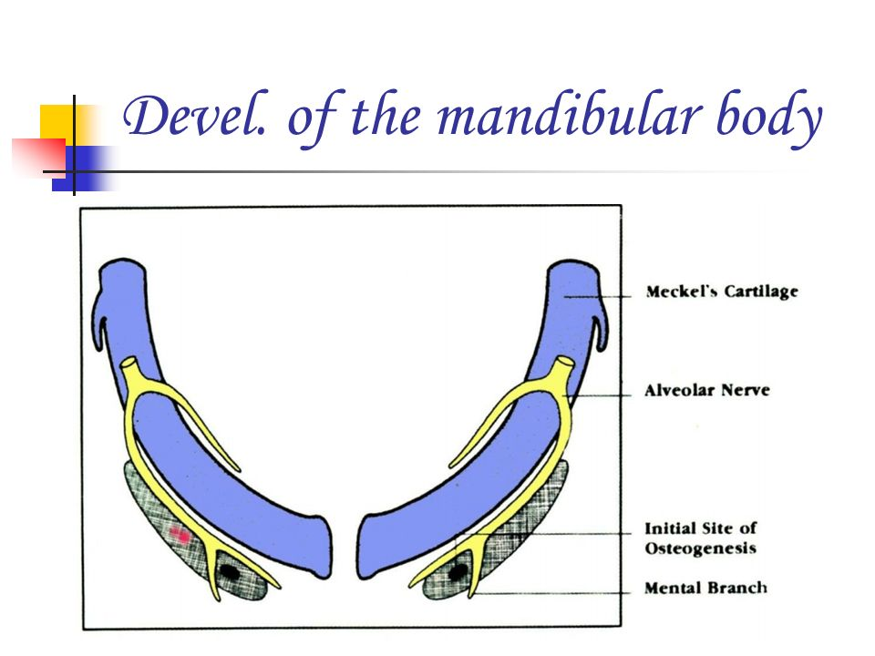
(A)Meckel’s Cartilage (B). Enferlor alveolar (C) Initiation of motion and theMeckel's cartilage

Slide 14
Endochondral bone formation
1. The condylar process
2. The coronoid process
Endochondral bone formation is seen only in 3 areas of the mandible:
3. The mental region.

Slide 15
Condylar process: At about the 5th week of intrauterine life, an area of mesenchymal condensation can be seen above the ventral part of the developing mandible.
This develops into a cone . shaped cartilageby about 10th week and starts Ossification by 14th week. It then migrates inferiorly and fuses with the mandibular ramus by about 4 months.
Much of the cone – shaped cartilage is replaced by bone by the middle of fetal life but its upper end persists into adulthood acting both as a growth cartilage and an articular cartilage.

Slide 16
Coronoid process: Secondary accessory cartilages appear in the region of the coronoid process by about the 10-14 week of intra-uterine life.
This secondary cartilage of coronoid process is believed to grow as a response to the developing temporalis muşcle.
The coronoid accessory cartilage becomes incorporated into the expanding intra-membranous bone of the ramus and disappears before birth.

Slide 17
Mental region: In the mental region, on either side of the symphysis, one or two small cartilages appear and ossify in the 7th month of intrauterine life to form variable numbers of mental ossicles in the fibrous tissues of the symphysis.
These ossicles become incorporated into the intra-membranous bone when the symphysis ossifies completely during the first year of postnatal life.

Slide 18
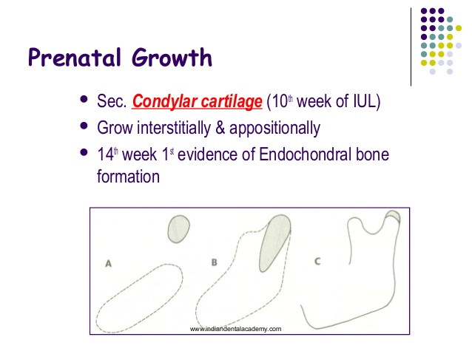
Condylar cartilage develops initially as a separate area and fuses with the mandibular body around the fourth month of intrauterine life.

Slide 19
POST NATAL GROWTH OF THE MANDIBLE
Of all the facial bones mandible undergoes maximum growth post natally. And also exhibits the largest variability in morphology.
Basal bone or body of mandible forms one unit, to which the alveolar process, the coronoid process, condylar process, angular process, ramus, lingual tuberosity and the chin.

Slide 20
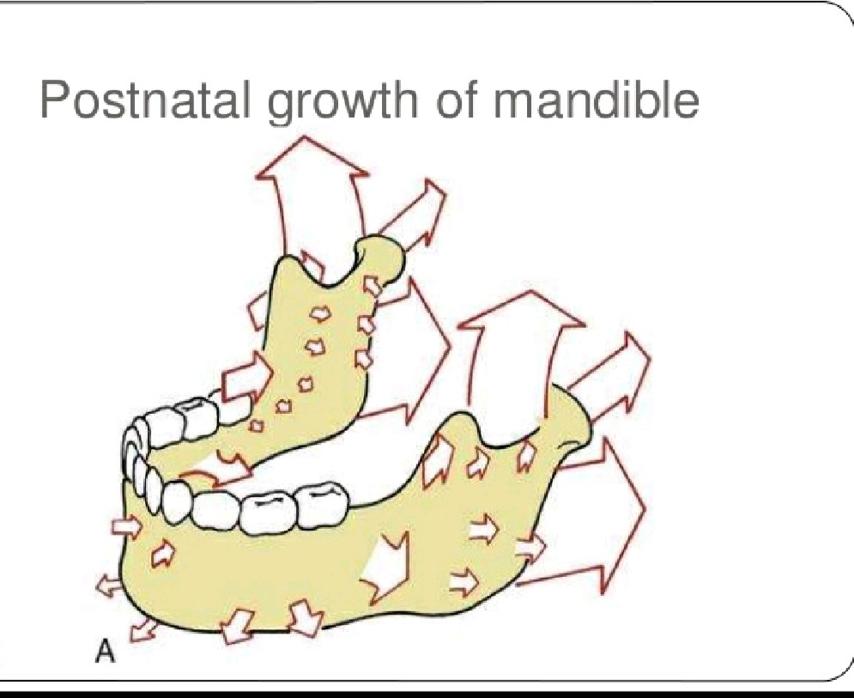

Slide 21
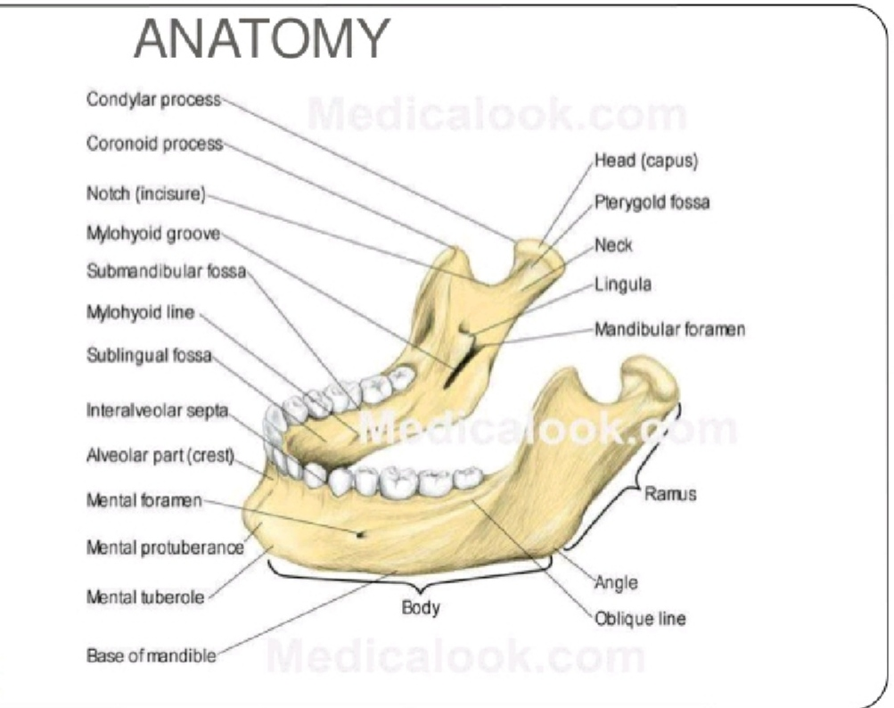

Slide 22
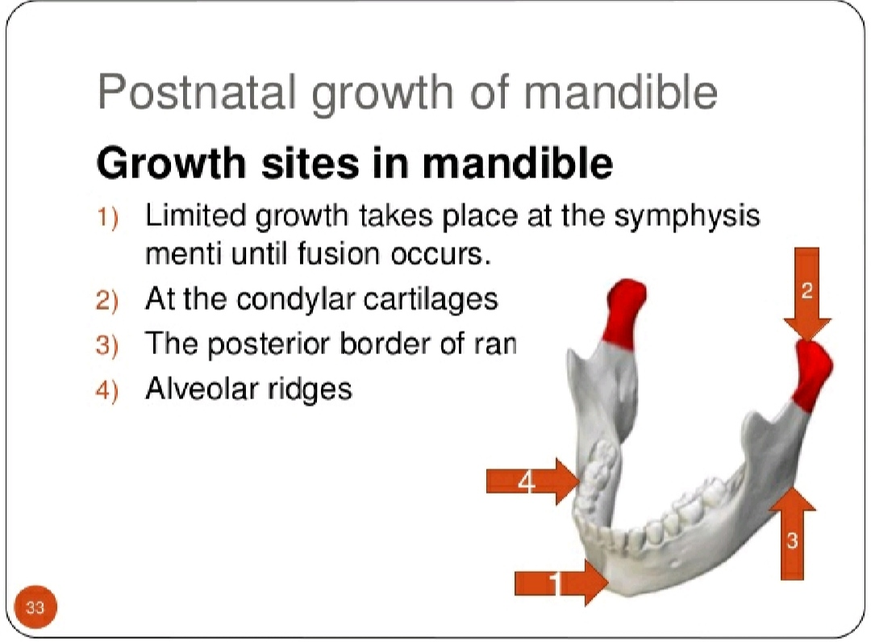

Slide 23
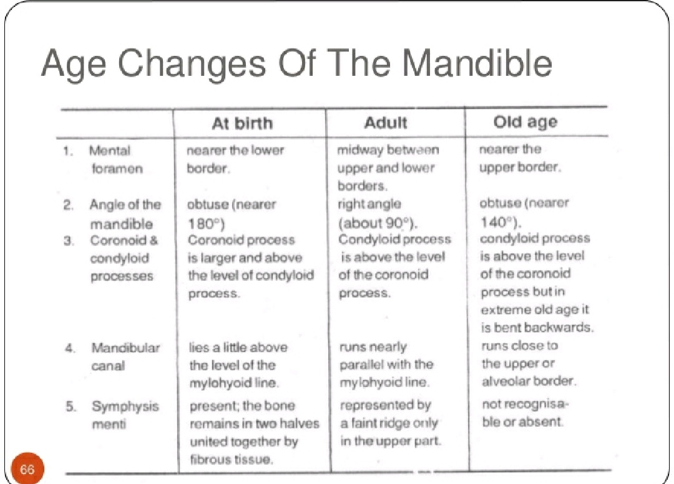

Slide 24
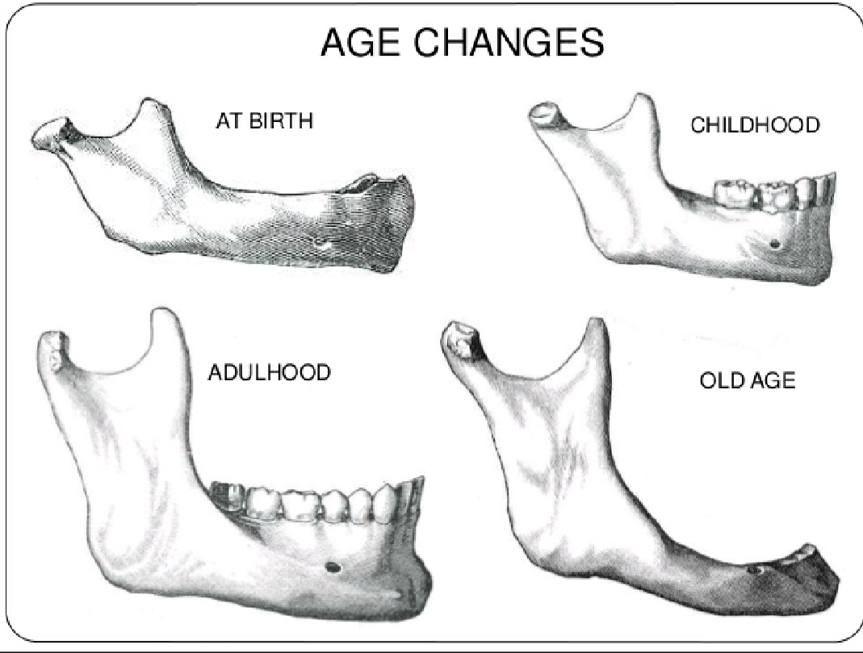

Slide 25
RAMUS OF MANDIBLE
Moves posteriorly by combination of deposition and resorption.
Resorption occurs on anterior region and deposition occurs on posterior region.
The functions of ramus remodeling are:-
To accommodate increasing mass of masticatory muscle.
To accommodate increased pharyngeal space
To facilitate the lengthening of mandibular body for erupting molars.

Slide 26
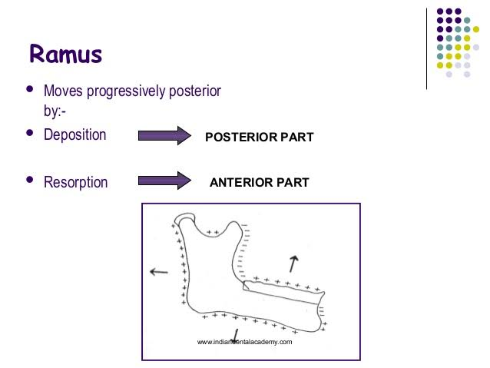

Slide 27
BODY OF MANDIBLE
Cortical drift of ramus of mandible leads to formation of posterior part of ramus of mandible.
In this manner body of mandible lengthens.
Additional space made available by resorption of anterior border of ramus of mandible to accommodate erupting molars.

Slide 28
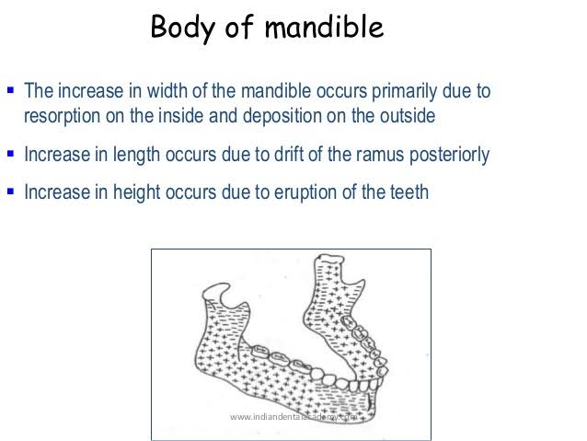

Slide 29
ANGLE OF MANDIBLE
On the lingual side of angle of mandible resorption of takes place on postero-inferior aspect while deposition takes place in antero-superior part.
On buccal side resorption takes place on antero-superior part while deposition takes place on postero-superior part.
This results in flaring of mandible as age advances.

Slide 30
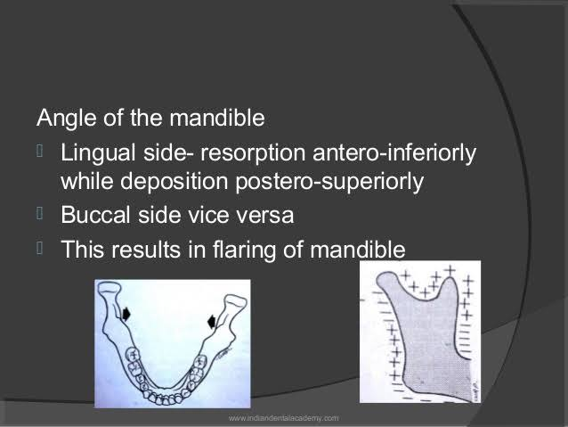

Slide 31
THE LINGUAL TUBEROSITY
Forms the boundary between ramus and the body of the mandible.
Lingual tuberosity moves posteriorly by deposition on its posteriorly facing surface.
Lingual tuberosity moves in the lingual direction and lies towards the midline of ramus.
Large resorption is seen that leads to the formation of lingual fossa

Slide 32
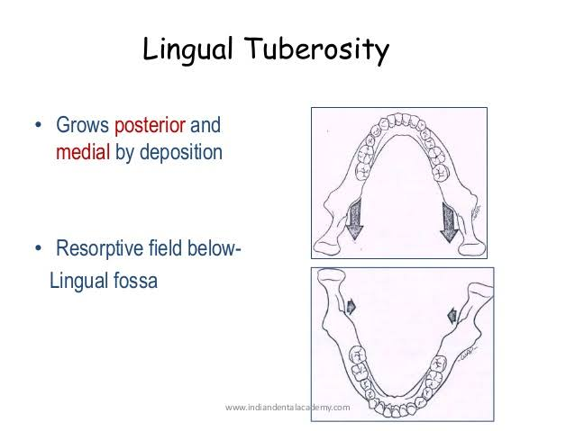
Combination of resorption and deposition in medial surface of tuberosity helps in formation of prominence of lingual tuberosity.

Slide 33
THE ALVEOLAR PROCESS
As the teeth erupts the alveolar process develops and increases in height by bone deposition at the margins.
Alveolar bone leads to increase in height and thickness of the body of mandible.
In case of absence of teeth the alveolar bone fails to develop and resorbs in case of extraction.

Slide 34
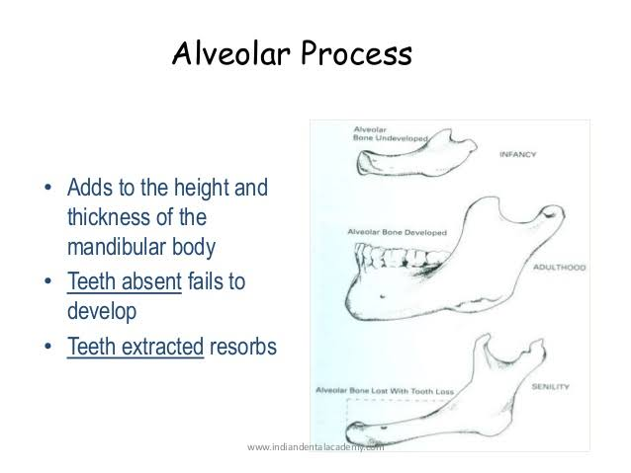

Slide 35
THE CHIN
>The chin is a specific human characteristic and is found in its fully developed form in recent man only.
>Usually males are seen to have prominent chins compared to females.
>The mental protuberance forms by bone deposition during childhood.
>Its prominence is accentuated by bone resorption that occurs in the alveolar region above it, creating a concavity.
>The deepest point in this concavity is known as 'point B' in cephalometric terminology.

Slide 36
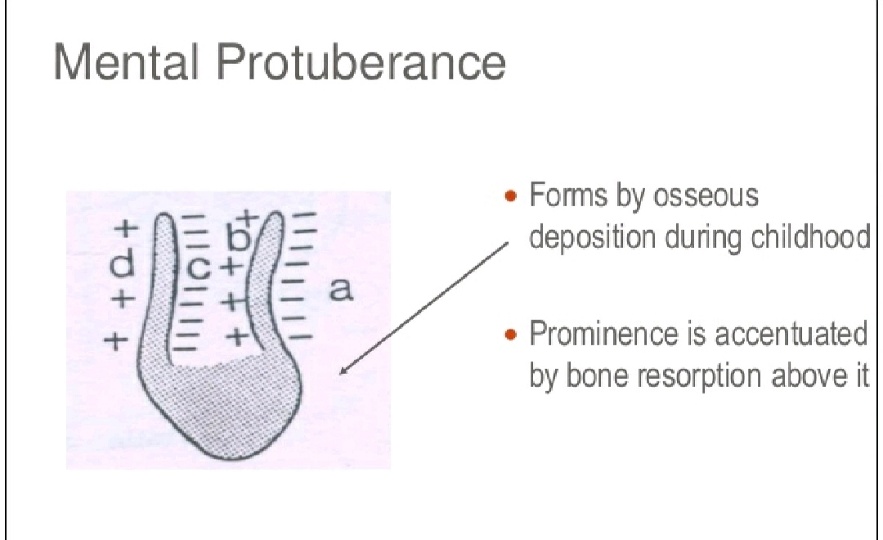
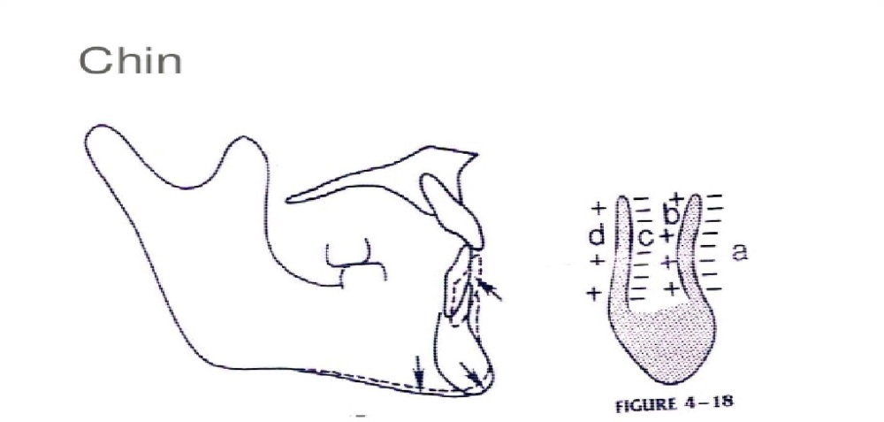

Slide 37
THE CONDYLE
>The mandibular condyle has been recognized as an important growth site.
>The head of the condyle is covered by a thin layer of cartilage called the condylar cartilage.
>The presence of the condylar cartilage is an adaptation to withstand the compression that occurs at the joint.
>The condylar growth rate increases at puberty reaching a peak between 12 1/2-14 years.

Slide 38
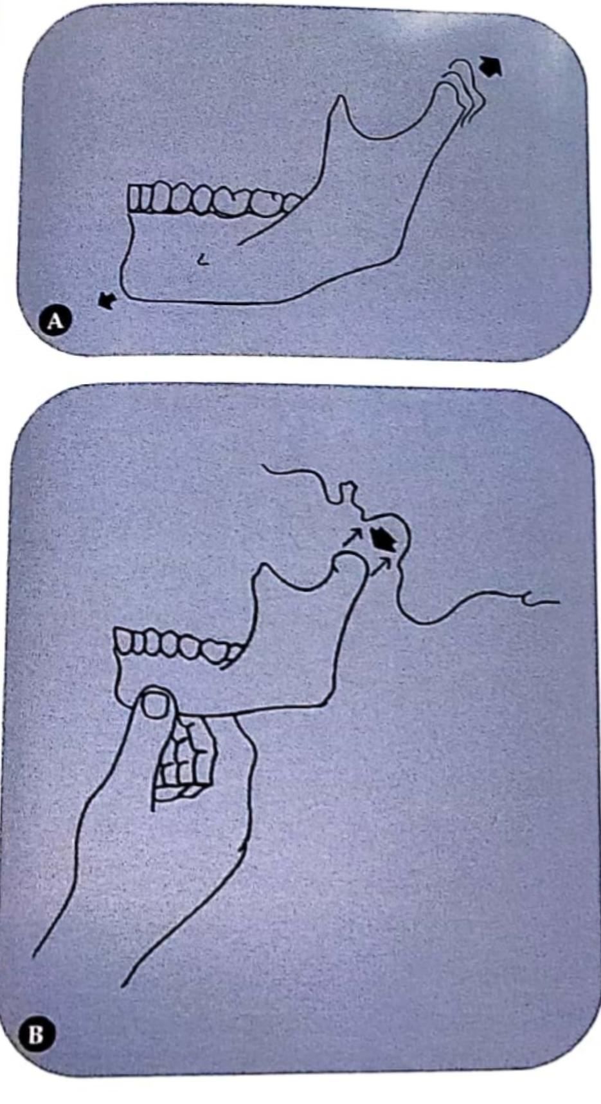
(A) Mandibular growth due to bonedeposition at the condylar cartilage.
(B)Mandibular growth at the condyle following the downward displacement of the mandible due to soft tissue growth.

Slide 39
THE CORONOID
>The growth of the coronoid process follows the enlarging 'V' principle.
>The deposition occurs on the lingual surfaces of the left and right coronoid process.
>This follows the “V” principle.
>Viewing it from the occlusal aspect, the deposition on the lingual of the coronoid process brings about a posterior growth movement in the 'V' pattern.

Slide 40
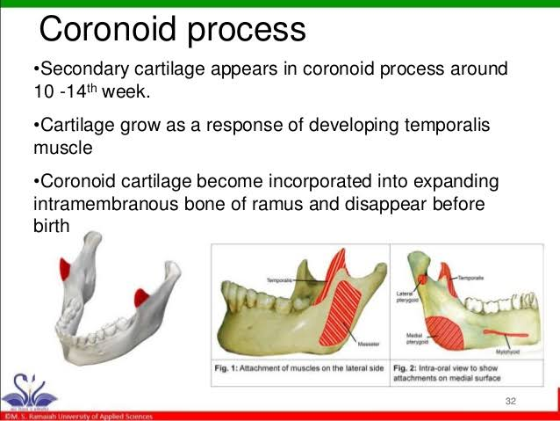

Slide 41
SUMMARY
Mandible is a unique bone, both by its structure and function.
It houses the only movable joint of the skull at both its ends.
Mandible has
a corpus,
two ramii,
two coronoid and
two condylar processes.
Functions of mandible include
(i) providing mobility to the jaws by the TMJ;
(ii) mastication by teeth and are the site of insertion of muscles of mastication;
(iii) maintenance of airway, ramal width coinciding with pharyngeal width.

Slide 42
REFERENCES
Textbook of Orthodontics – Gurkeerat Singh, Jaypee Brothers; 2nd Edition
Orthodontics – The Art and Science, S.I Bhalajhi, AryaMedi Publishing; 7th Edition
Textbook of Orthodontics – Sridhar Premkumar, Elsevier; 1st Edition
Orthodontics: Diagnosis and Management of Malocclusion and Dentofacial Deformities – O.P Kharbanda, Elsevier; 1st Edition

Slide 43
Question & Answer Session

Slide 44
THANK
YOU

